Slide 1

BANK MANAGEMENT SYSTEM
BY,
S.S.SURYAH
XII-A
6009

Slide 2

INTRODUCTION
"BANK MANAGEMENT SYSTEM" This project is useful for the bank employees as well as customers to keep a track of account details. The emerging of digital system made information available on finger tips. By automating the transactions one can view the details as and when required in no time. This project emphases on creation of new customer accounts, managing the existing account holders in the bank, by making digital system one can generate daily reports, monthly reports and annual reports which can enhance the system.

Slide 3
SOURCE CODE
import mysql.connector as sql
conn=sql.connect(host='localhost',user='root',passwd='manager’
database='bank')
if conn.is_connected():
print('connected succesfully')
cur = conn.cursor()
cur.execute('create table customer_details(acct_no int primary key,acct_name varchar(25) ,phone_no bigint(25) check(phone_no>11),address varchar(25),cr_amt float )')

Slide 4
import mysql.connector as sql
conn=sql.connect(host='localhost',user='root',passwd='manager',
database='bank')
cur = conn.cursor()
conn.autocommit = True
print('1.CREATE BANK ACCOUNT')
print('2.TRANSACTION')
print('3.CUSTOMER DETAILS')
print(‘4.TRANSACTION DETAILS’)
print('5.DELETE DETAILS')
print('6.QUIT')
n=int(input('Enter your CHOICE='))
if n == 1:
acc_no=int(input('Enter your ACCOUNT NUMBER='))
acc_name=input('Enter your ACCOUNT NAME=')
ph_no=int(input('Enter your PHONE NUMBER='))
add=(input('Enter your place='))
cr_amt=int(input('Enter your credit amount=')) V_SQLInsert="INSERT INTO customer_details values (" + str (acc_no) + ",' " + acc_name + " ',"+str(ph_no) + ",' " +add + " ',"+ str (cr_amt) + " ) "
cur.execute(V_SQLInsert)
print('Account Created Succesfully!!!!!')
conn.commit()

Slide 5
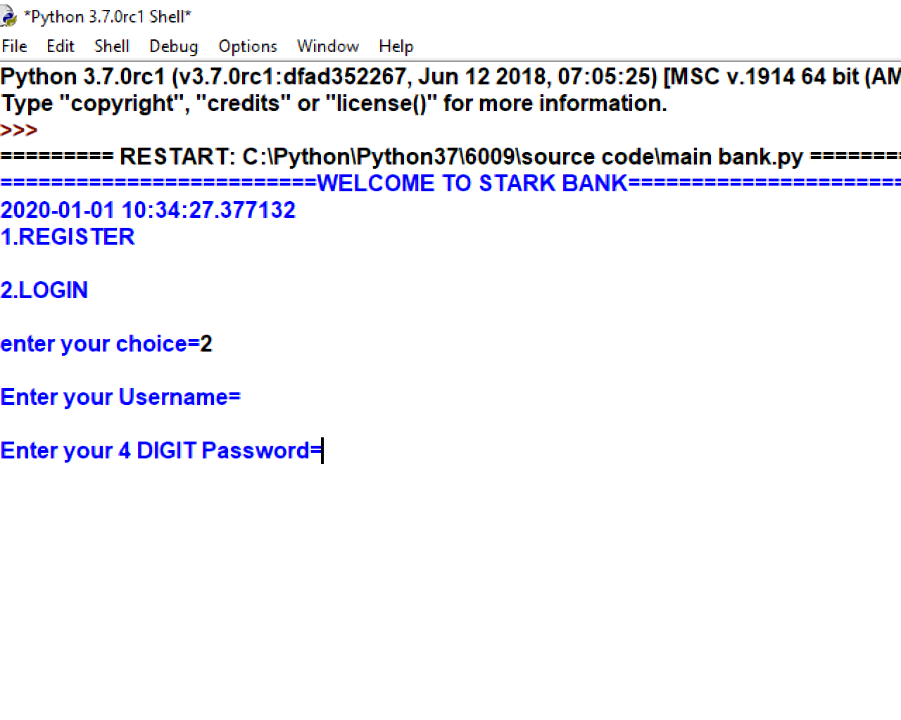
OUTPUT

Slide 6
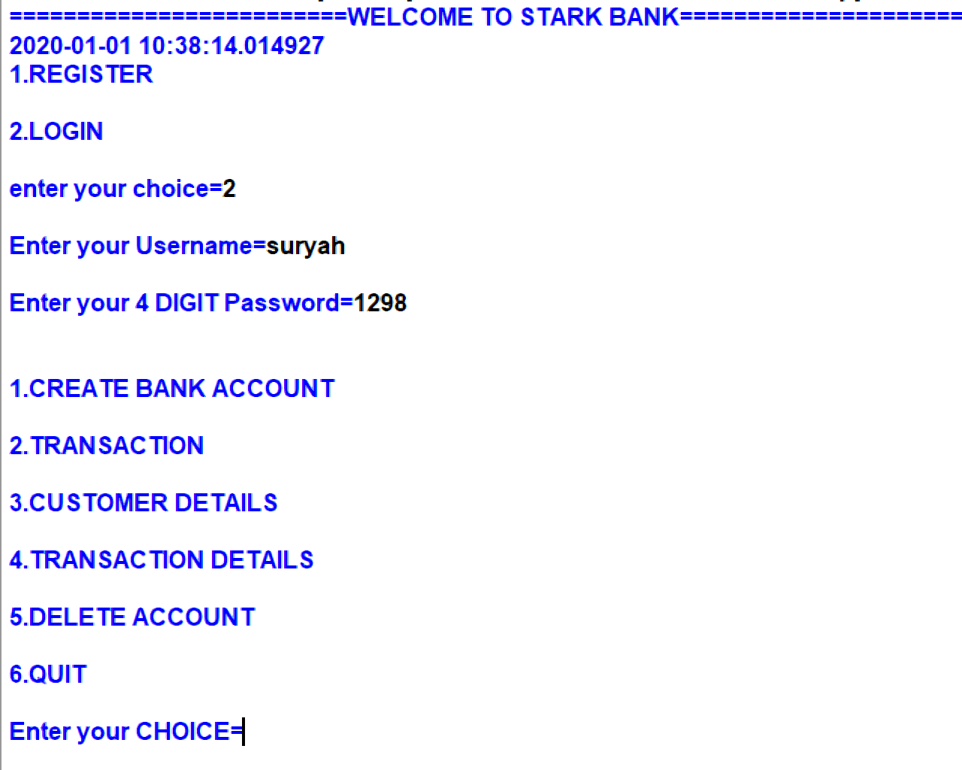

Slide 7
INSTALLATION PROCEDURE
Install python and my sql from the web.
Open mysql and create the database bank
Then run the table.py file.
Next run the user_table.py file.
Then the transactions_table.py file .
Open the main bank file.
Then register your account.

Slide 8

THANK YOU

